Slide 1
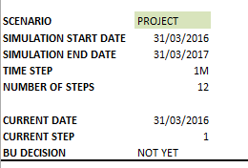




SIMULATION GENERAL EXPLANATIONS
Scenario: Chose a scenario. Each scenario includes different simulation conditions.
Time Step: Time step is a property of a scenario. Could be Daily(1D), Weekly(1W) or Monthly(1M). The amount of time that will pass when the all the decisions are made and day is closed.
Number of Steps: Number of the decision periods in the simulation scenario.
Current Date: The date that the user currently making decisions.
BU Decision: At each time period user has only have one chance to make decisions about the deposit and loan growth. This cell shows for the current time step if the business decisions are made or not.
Cash Balance: Shows the opening balance and the closing balance of the cash for the current time step for each currency.
Liquidity: Shows the repo capacity after the haircuts. Repo in use and the free repo capacity.
Reserve Requirement: Shows the free cash that should be hold on the central bank accounts.
CTL Limits: Counterparty money market limits. There are 3 counterparties in the simulation.

